Slide 1
L04.01
Binary Search Trees (BST)
50.004 Introduction to Algorithm
Dr. Simon LUI
ISTD, SUTD

Slide 2
Overview
We will talk about a runway reservation system
Use an array/list to solve it
  In O(n) time
Use Binary Search Tree (BST) to solve it
  In O(height) time
    usually height = logn,
    but in the worst case height = n-1

Slide 3
Runway reservation system
Problem definition:
  Single (busy) runway
  Reservations for landings
    maintain a set of future landing times (R)
    a new request to land at time t
    add t to R if no other landings are scheduled within < 3 minutes from t
    when a plane lands, remove its reservation from the set

Slide 4
Runway reservation system
Example
  R = (41, 46, 49, 56)
  requests for time:
    40 => reject (crash with 41)
    42 => reject (crash with 41)
    53 => ok
    20 => not allowed (already past)

Slide 5
Proposed algorithm
Complexity? O(n)
Can we do better?
init: R = [ ]
req(t): if t < now: return "error"
for i in range (len(R)):
if abs(t-R[i]) < 3: return "error"
R.append(t)
R = sorted(R)
land: t = R[0]
if (t != now) return error
R = R[1: ] (drop R[0] from R)

Slide 6
Some options:
Keep R as a sorted list:
  insert new element in proper place: O(n)
  <3 minute check: O(1)
Keep R as a sorted array:
  Find the place to insert new element: O(logn)
  <3 minute check: O(1)
  Insert (shifting of elements): O(n)
Keep R in unsorted order (array of a heap):
  search for collisions: O(n)
To improve it, we need fast insertion
Notes:
Heaps: cannot do the 3 minute check fast!

Slide 7
Binary Search Trees (BSTs)
Binary Search tree:
Each node x has:
  key[x]
  Pointers:
    left[x]
    right[x]
    parent[x]
10
x
5
12
1
6
7

Slide 8
Binary Search Trees (BSTs)
Binary Search tree:
  Property:
  Key[left[x]] < key[x]
  Key[x] < key[right[x]]
10
5
12
x
1
6
Left[x]
Right[x]
7

Slide 9
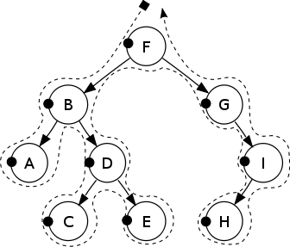
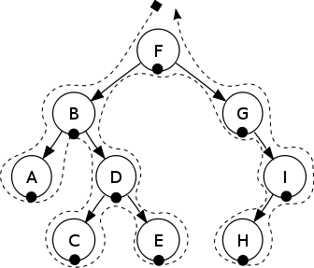

Tree traversals
Algorithms to output the tree nodes
Pre-order: FBADCEGIH
In-order: ABCDEFGHI
Post-order: ACEDBHIGF
(In-order = sorted list of BST)
Pre-order
In-order
Post-order

Slide 10
Growing BSTs
root
Insert 10
Insert 12
Insert 5
Insert 1
Insert 6
Insert 7
3
10
2
5
12
height
1
1
6
0
7

Slide 11
Use BST for the runway problem
49
Operations:
insert(k) (with “< 3 minute check”)
find(k): finds the node containing key k (if it exists)
findmin(x): finds the minimum of the tree rooted at x
deletemin(): finds the minimum of the tree and delete it
next-larger(x): finds the next element after element x
41
56
37
46
Notes:
Explain findmin(x) (simple)

Slide 12
Next-larger
3 cases to consider!
10
next-larger(x):
if right[x] ≠ NIL then
return findmin(right[x])
else
  y = parent[x]
  while y≠NIL and x=right[y] do
    x = y
    y = parent[y]
  return y
5
12
1
6
5.5
7
5.3

Slide 13
Next-larger
3 cases to consider!
10
next-larger(x):
if right[x] ≠ NIL then
return findmin(right[x])
else
  y = parent[x]
  while y≠NIL and x=right[y] do
    x = y
    y = parent[y]
  return y
5
12
x
1
6
5.5
7
5.3
Example 1: next-larger(5) = 5.3

Slide 14
Next-larger
3 cases to consider!
10
next-larger(x):
if right[x] ≠ NIL then
return findmin(right[x])
else
  y = parent[x]
  while y≠NIL and x=right[y] do
    x = y
    y = parent[y]
  return y
5
12
y
1
6
x
5.5
7
5.3
Example 2: next-larger(1) = 5

Slide 15
Next-larger
3 cases to consider!
10
next-larger(x):
if right[x] ≠ NIL then
return findmin(right[x])
else
  y = parent[x]
  while y≠NIL and x=right[y] do
    x = y
    y = parent[y]
  return y
5
12
1
6
y
5.5
7
x
5.3
Example 3: next-larger(7) =

Slide 16
Next-larger
3 cases to consider!
10
next-larger(x):
if right[x] ≠ NIL then
return findmin(right[x])
else
  y = parent[x]
  while y≠NIL and x=right[y] do
    x = y
    y = parent[y]
  return y
5
12
y
1
6
x
5.5
7
5.3
Example 3: next-larger(7) =

Slide 17
Next-larger
3 cases to consider!
10
next-larger(x):
if right[x] ≠ NIL then
return findmin(right[x])
else
  y = parent[x]
  while y≠NIL and x=right[y] do
    x = y
    y = parent[y]
  return y
y
5
12
x
1
6
5.5
7
5.3
Example 3: next-larger(7) = 10

Slide 18
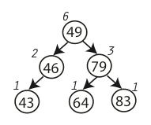
Augmenting a BST
1. Keep the total size of sub-trees at each node

Slide 19
Back to runway reservation system
This can help us to answer “How many planes will land before t=79?”
Answer:
leftsubtree(79) + parentnode(79) +
leftsubtree(parent of 79)
= (64) + (49) + left(49)
= 1 + 1 + 2
= 4

Slide 20
Analysis
We have seen insertion, search, findmin…
How much time does any of this take ?
Worst case: O(height)
=> height is really important
After we insert n elements, what is the worst possible BST height ?
10
5
12
1
6
7

Slide 21
Analysis
1
n-1
so, still O(n) for the runway reservation system operations in the worst case, if the height is bad
5
6
7
10
12

